Slide 1


Post COVID-19: Reopening a Restaurant
Property Training
November 2020
Bruce A. Tagg, ALCM
Senior Engineering Exposure Analyst

Slide 2
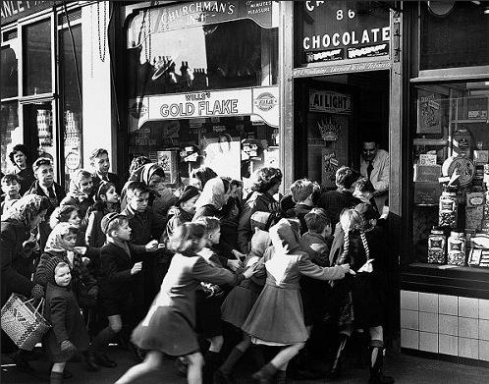

Reopening a Restaurant Post COVID-19
It’s as easy as turning on the lights and opening the doors…isn’t it?

Slide 3
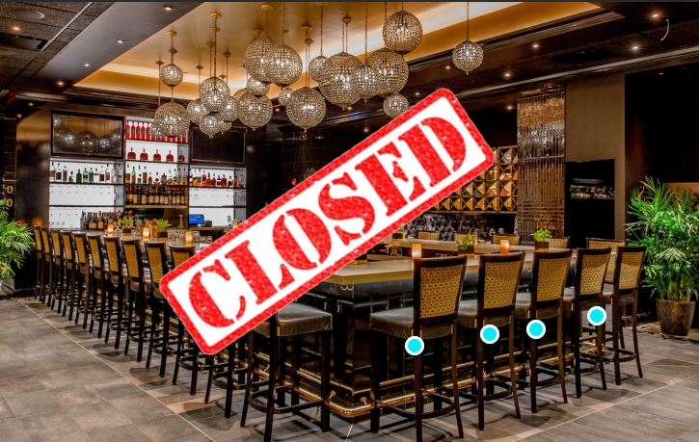
COVID-19 Shutdowns Are Not Normal Shutdowns
No preparation
No prior experience
Restarting requires unique steps
  Equipment issues
  Employee issues
  Supply chain issues
Hence planning is critical

Slide 4
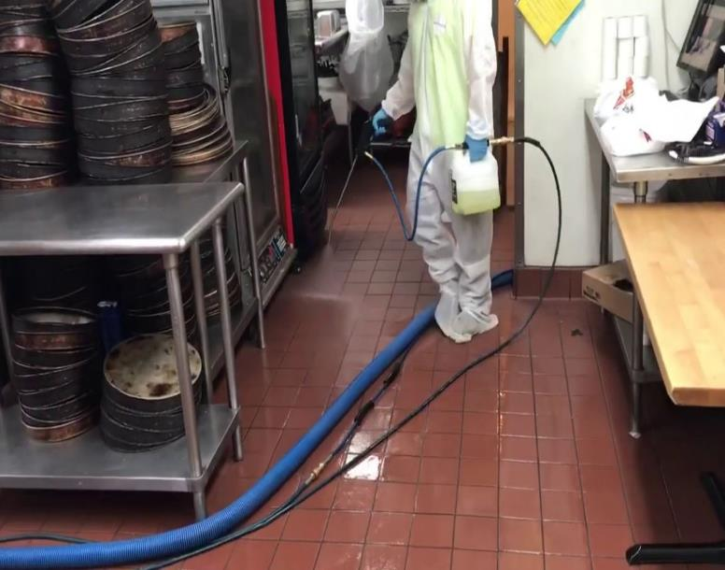
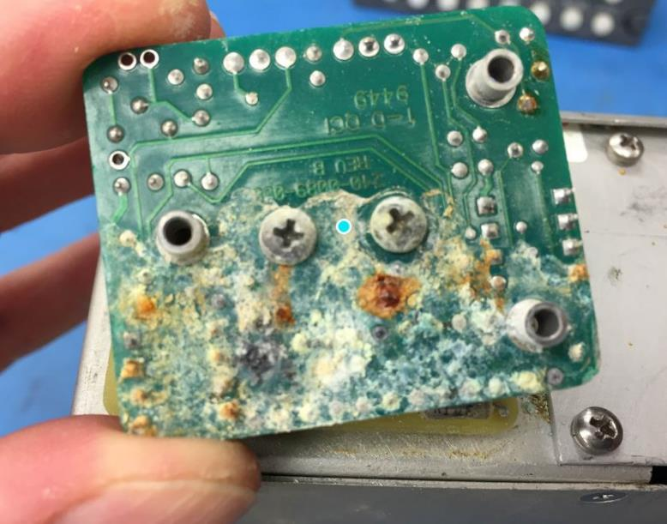
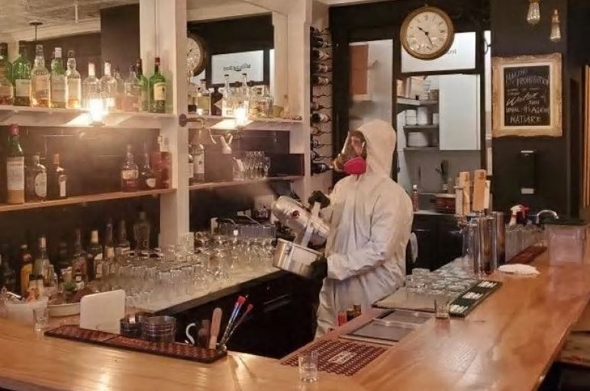
COVID-19 Shutdown: Disinfectant/Cleaning Issues
Disinfectant Process
  Fogging equipment
  Impact on electronics

Slide 5
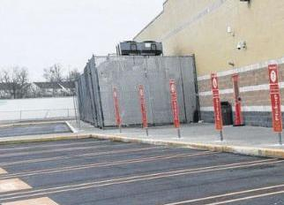
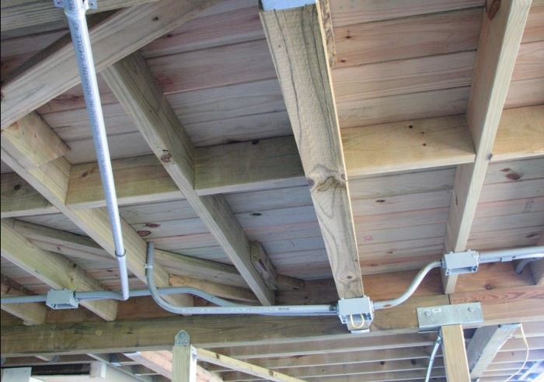
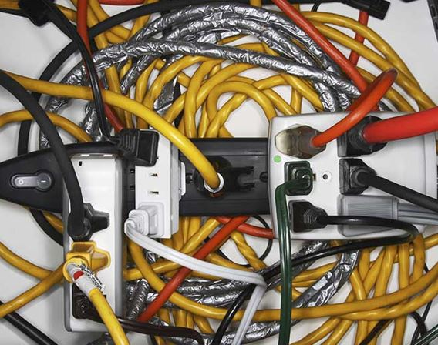

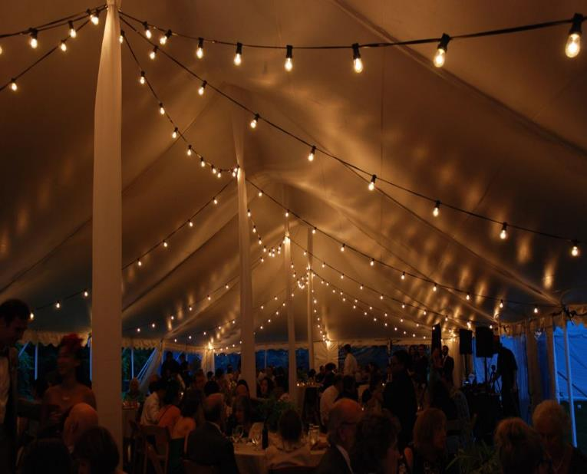
COVID-19 Shutdown: Electrical Issues
Alterations/Additions
  Movement of equipment
  Use of temporary wiring/extension cords
  Load issues
    Additional coolers for changed ops
  Staged startup

Slide 6
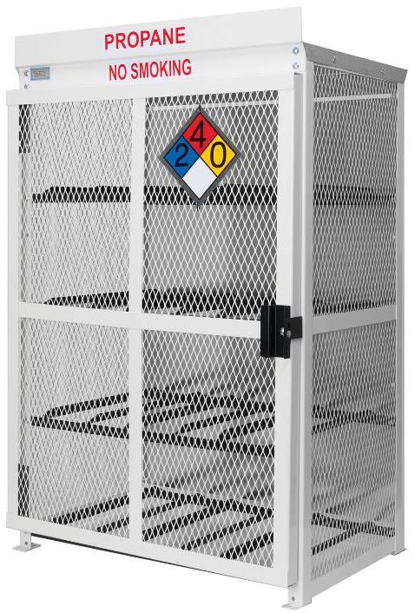
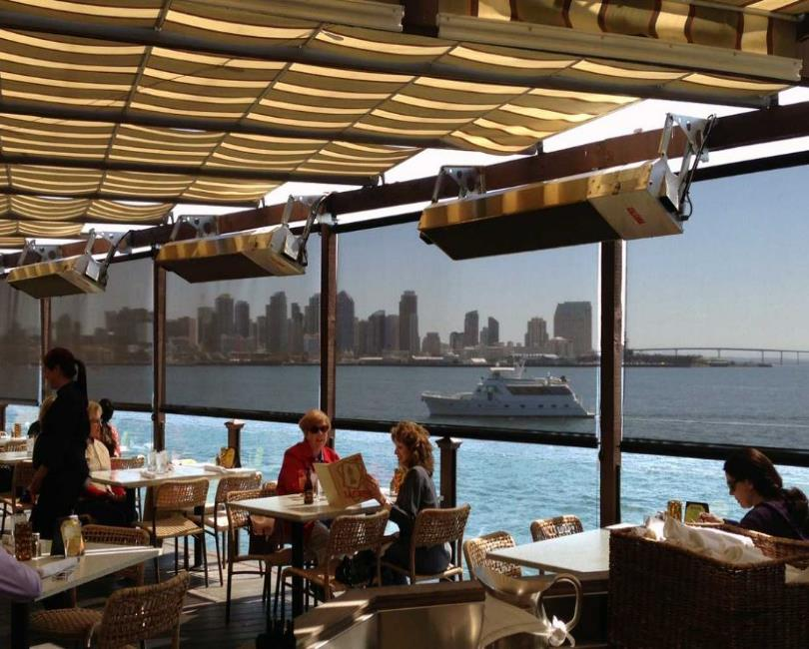
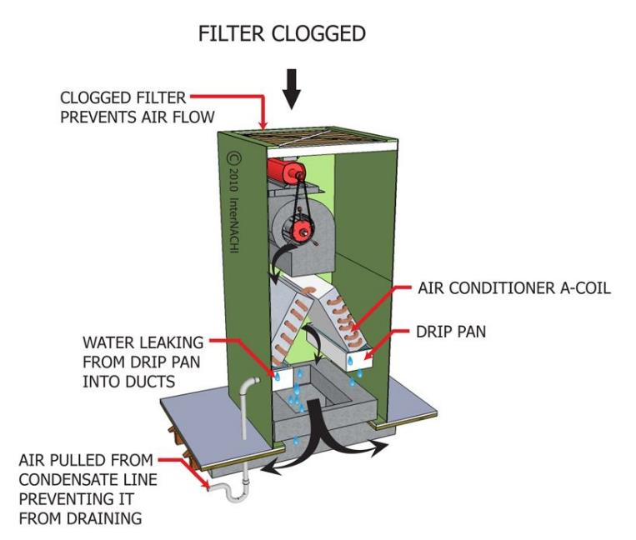
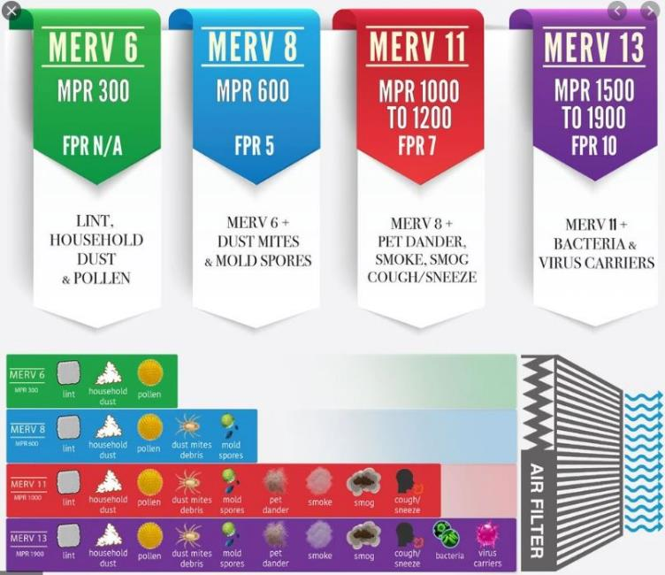
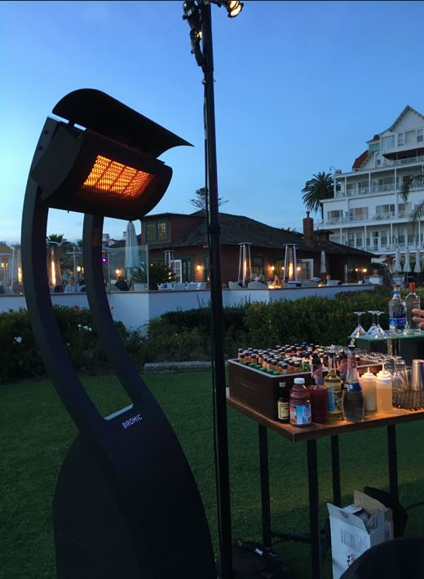
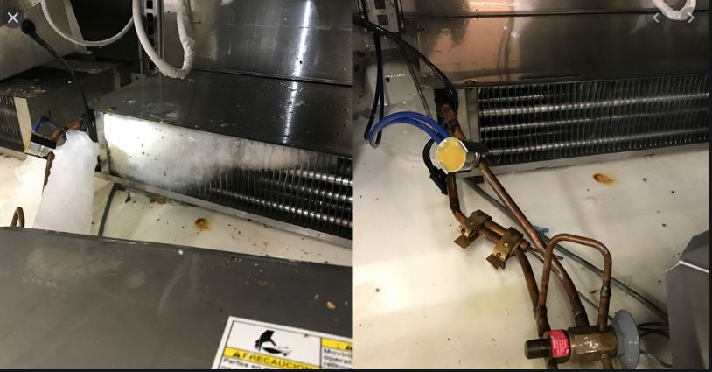
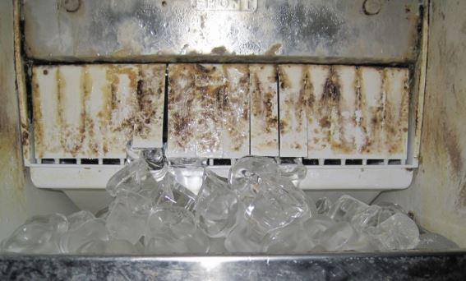
COVID-19 Shutdown: Other Building System Issues
HVAC
  Inspect system
  Improve filters (MERV 13, HEPA, UV)
  Increase air flow
Refrigeration
  Improper shutdown
  Cleaning/sanitizing
Outdoor/Temporary Dining

Slide 7
What’s the Takeaway
Plan for reopening
Assign management person to oversee
Perform Risk Assessment Inspection of facility
Complete any deferred maintenance
Have equipment inspected/serviced by qualified service technician
Verify equipment that was changed or moved is returned to proper condition
Inspect electronics if facility was fogged
Update/retrain employees

Slide 8
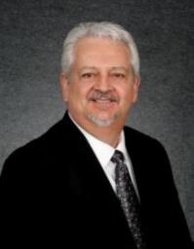
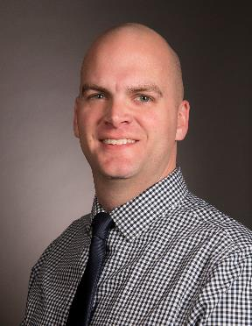
Questions
MBRe Engineering Property Training Team
Bruce A. Tagg, ALCM
Senior Engineering Exposure Analyst
Mutual Boiler Re – a member of the FM Global Group
bruce.tagg@mutualboilerre.com
1 (610) 407-7825
James Wible
Senior Engineering Exposure Analyst
Mutual Boiler Re – a member of the FM Global Group
james.wible@mutualboilerre.com
1 (412) 337-0920

